Slide 1
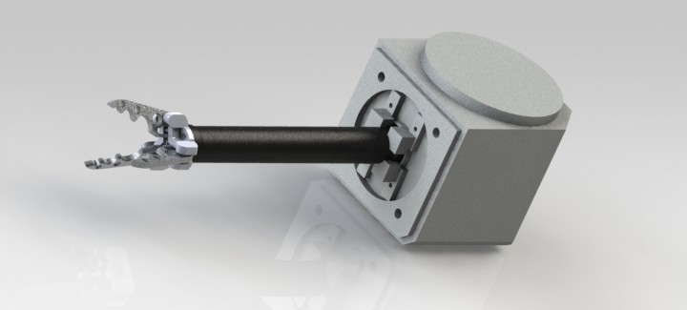
Magneto coupled actuators
Intern: Erick Yanez
Mentor: Shea Ferring
NASA Space Grant Robotics Team
Notes:
Blue and red really clash…. You can leave out the name of the team but mention it verbally

Slide 2

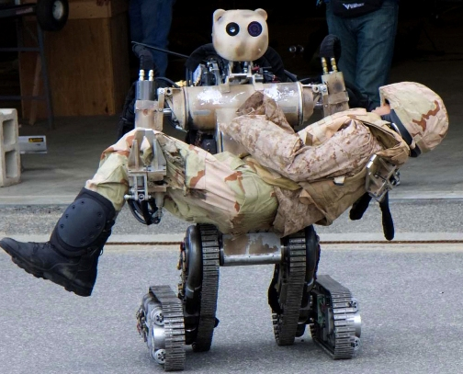
Manipulators
Manipulators are the platform through which a robot interacts with its environment
Notes:
I added the word manipulators to the bullet to make it a complete sentence

Slide 3
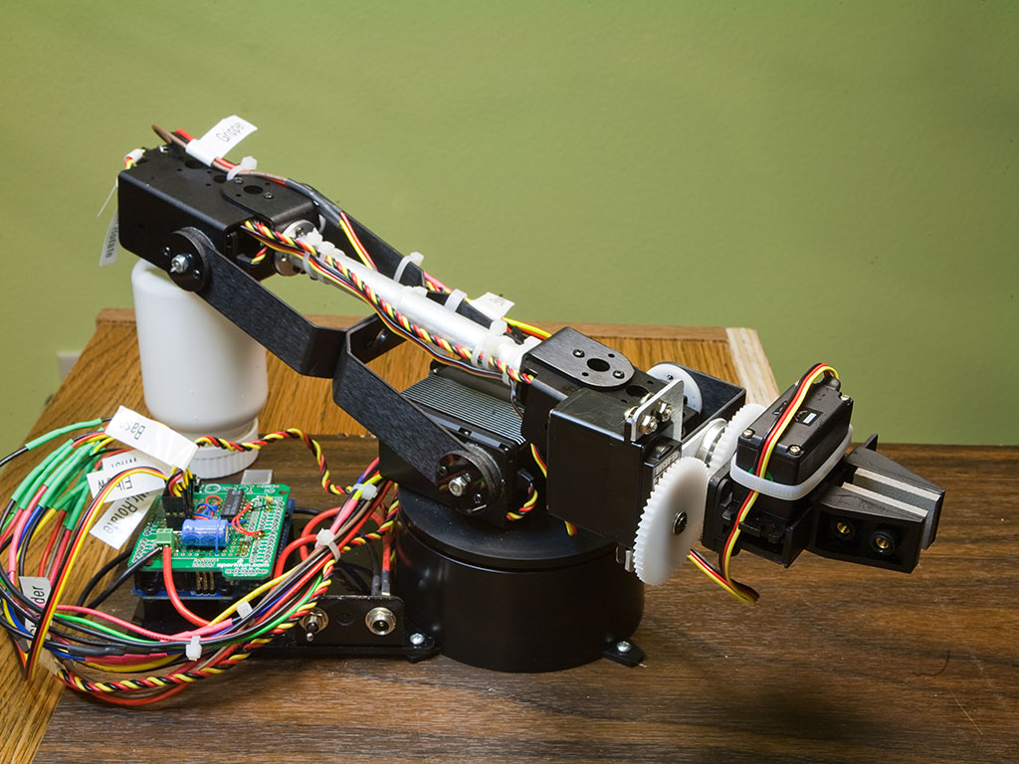
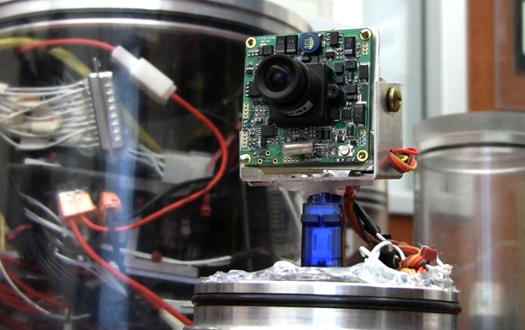
Manipulators
Inside those manipulators and the robots there exist a plethora of different parts and circuits.
Notes:
Points for using the word plethora

Slide 4
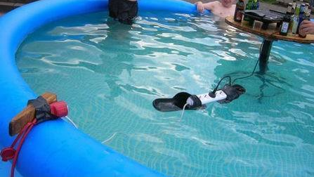
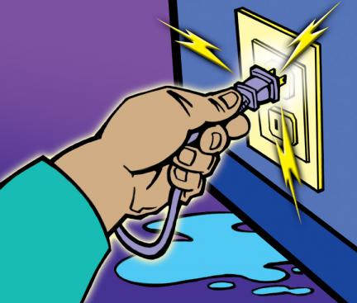
Electricity Problem
Mixing electricity and water usually doesn't end well.
Hence precautions must be taken when dealing with environments that contain water.
Notes:
Problem should be capitalized since it’s a title, that goes for the rest of the slides as well

Slide 5
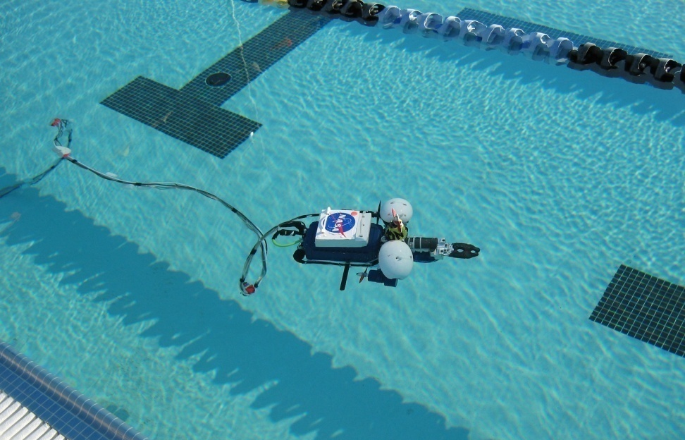
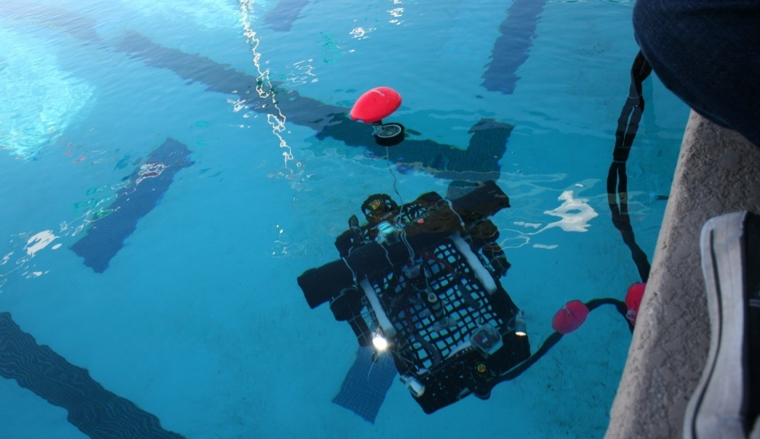
Underwater Robotics
The ROVs (Remotely Controlled Vehicle )from the robotics team do not only have to interact with water, they are surrounded by it
Notes:
Center both pictures, ROV is an acronym Remotely Controlled Vehicle and needs to be capitalized. Sentence is a little awkward. Maybe try, “The ROVs from the robotics team do not only have to interact with water, they are surrounded by it”

Slide 6
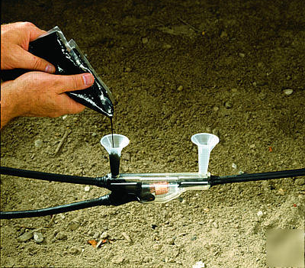
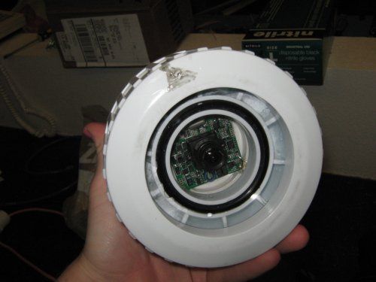
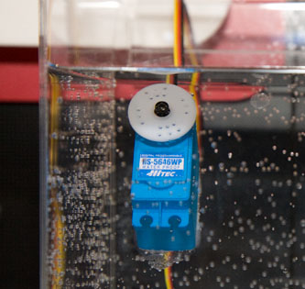
Underwater Robotics
All of the circuits and motors on the ROVs must be water-proof.
Utilizing methods of static and dynamic sealing and pre-waterproof components.
Scotch cast
O-ring seal
Pre-waterproofed servo
Notes:
No space between Under water, and again capitalize every word in the title. Mention the types of methods use, I know you have the picture and maybe you just need captions, but state the use of scotchcast or RTC (room temperature vulcanizer), orings, etc. Also, all these methods are mainly for static seals. Dynamic seals are shaft seals and grease seals which are difficult to utilize. And has a lot of wear and tear that limits their lifespan

Slide 7
Underwater Manipulators
Problem: Dynamic seals are very difficult, are more costly, and can require more maintenance than static seals
Solution: Develop a method of dynamic movement that is water-proof but does not require dynamic sealing or water-proof motors.
Notes:
Dynamic seals can fail, are more costly, and requires maintenance (capitalize Dynamic)

Slide 8
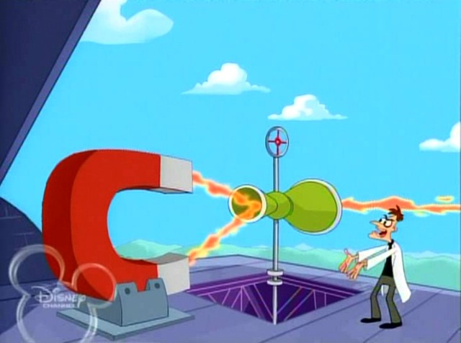
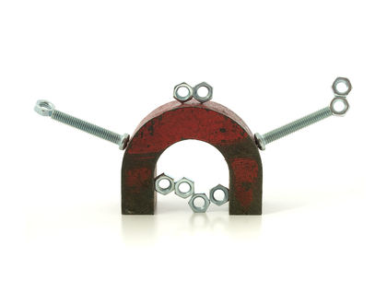
Magneto Coupled Actuators
A magneto coupled actuator can utilize virtually any actuator without the need of traditional dynamic water-proofing.
Utilizing only static-water proofing methods and magnetism!

Slide 9
Multi-Axis Magneto Coupled Manipulator
The end goal of my internship is to develop a multi axis manipulator utilizing the magneto couple actuators
The first section of the manipulator will be wrist type movement which will allow the claw to rotate about its center of mass.
Notes:
New slide

Slide 10
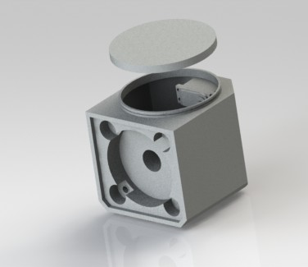
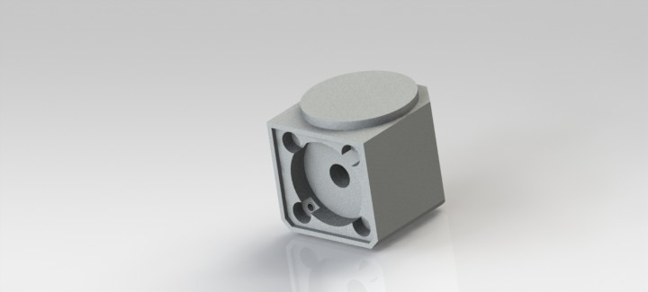
Magneto Coupled Actuators
To keep the servos and circuits happy and dry they are situated in a specially designed container.

Slide 11
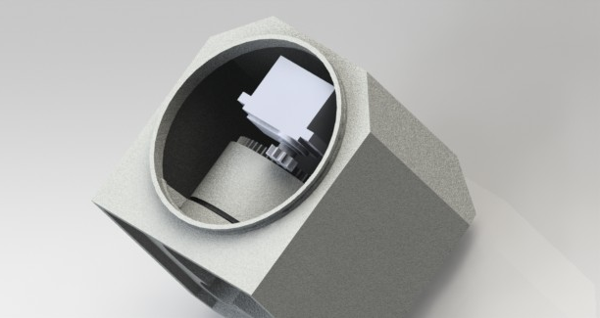
Magneto coupled actuators
Servo turns the inner magnetic ring
Servo
Magnetic
ring
Notes:
Identify the inner magnetic ring and the servo

Slide 12
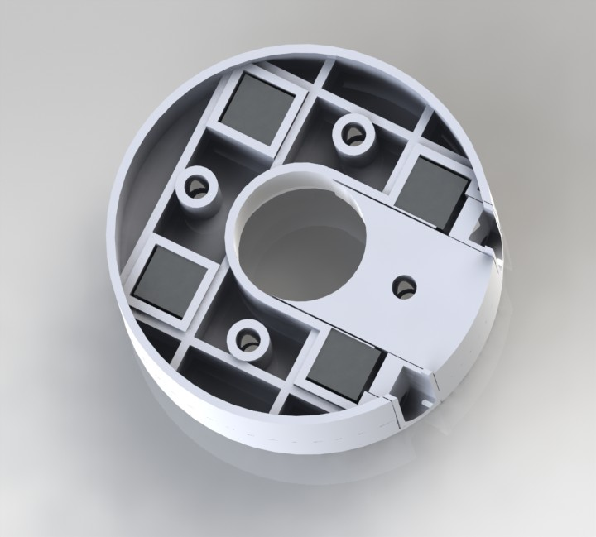
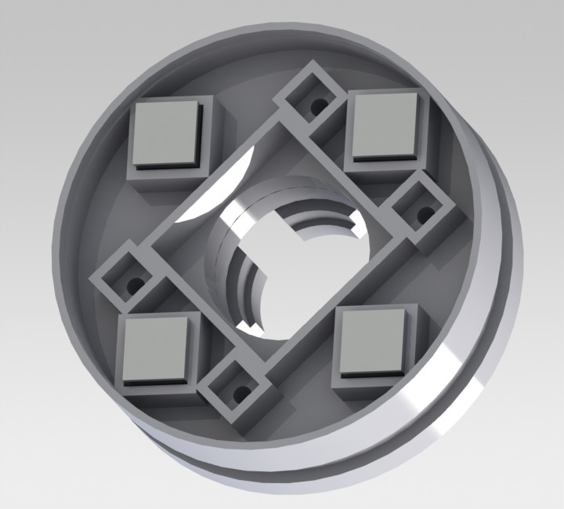
Magneto Coupled Actuators
Inner ring of magnets is coupled with outer set of magnets.
Notes:
nice

Slide 13
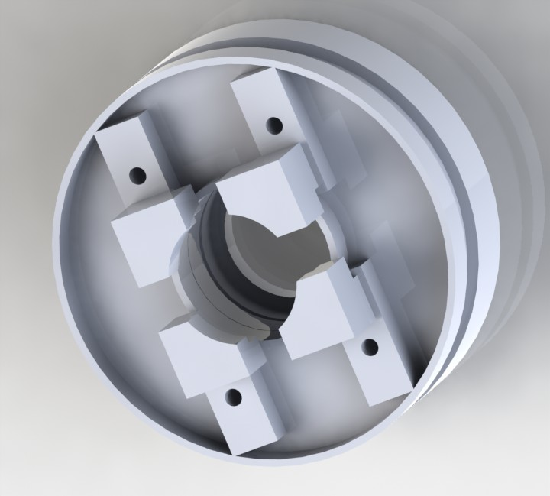
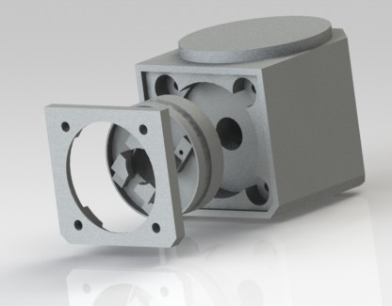
Magneto Coupled Actuators
The external holder with its corresponding magnetic ring sits inside its designated area and is covered.
External
holder
Cover
Notes:
Very nice

Slide 14
Magneto Coupled Actuators
As the servo rotates the inner magnetic ring, the external magnetic ring follows its counter-part and rotates the claw attached to it.

Slide 15
Magnetic Coupling Actuators
The magnetic rings continuously attract one another, applying torque to the solid surface.
(solid works video of inner magnets moving)

Slide 16
Slippage
Current model is designed for low torque output as slippage can occur at higher speeds
Slippage is when the magnetic force between the two magnets is no longer strong enough to hold then together and the magnets slip out of place
Notes:
How is the system designed for realignment? How do continuous servo and magnets placement allow for simple self alignment?

Slide 17
Slippage
System is designed to realign if slippage does occur
  As each magnets connection to one another is not important
  Continuous rotation servos and magnet placement allows for simple self alignment

Slide 18
Benefits
Being statically sealed means the actuator robustness depends on material used to construct shell.
Capable of continuously rotating
Virtually any servo or motor can be used as a control source

Slide 19
Further Applications
Current model is for rotational wrist movement
A modified version of the holder section of the system could be used for
  Linear movement
  Lead screw assemblies

Slide 20
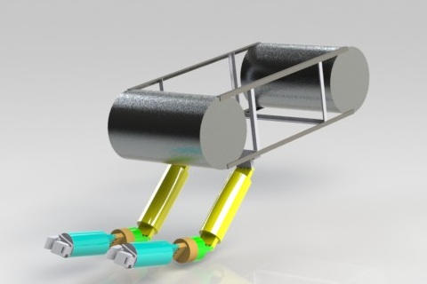
Manipulators
Magnetic coupling actuators can be developed to power most if not all types of motions desired in underwater manipulators and other harsh environments.
Notes:
What about adding your picture of the two 3dof arms here?

Slide 21
Questions?

